Slide 1

Work Related learning
LO 4-Week 10-
Examine the relationship between the organisation and its stakeholders

Slide 2
Learning outcomes
At the end of this class , students will be able ;
1-Define stake holders in health and social Care .
2-Outline the roles of stakeholders in Health and Social Care .

Slide 3

LO1- Activity -10 mins
Conduct internet Research ;
What is stakeholders. Identify Stakeholders in Health and social Care
Feedback To the class.

Slide 4
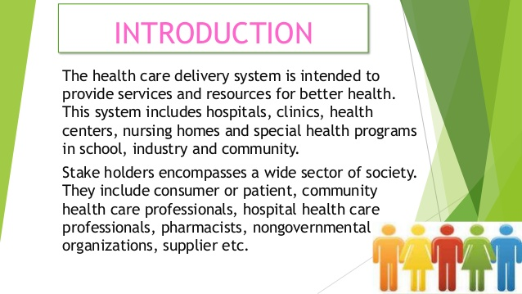
Role of a stakeholder
A stakeholder is a person who has an interest in the company, IT service or its projects. They can be the employees of the company, suppliers, vendors or any partner. Stakeholders can also be an investor in the company and their actions determine the outcome of the company.
Who are internal stakeholders in healthcare?
Internal stakeholders are people who are already committed to serving your organization as board members, staff, volunteers, and/or donors. External stakeholders are people who are impacted by your work as clients/constituents, community partners, and others. It is important to get the perspectives of both groups.

Slide 5
WHO ARE STAKEHOLDERS?
Any group or individual who can affect or is affected by the performance of the achievement of the organisation’s objectives. Any person group or organisation that can place a claim on the organisation’s attention, resources, or output, or is affected by that output. People or small groups with the power to respond to, negotiate with, and change the strategic future of the organisation. Stakeholders are the individuals and groups affected by and capable of influencing the development and implementation of strategy and policy proposals.

Slide 6
What Is a Stakeholder?
A stakeholder is a person (or entity) who can affect and/or be affected by your organization—who, in other words, has a stake in your work.
Stakeholders (such as volunteers, donors, and vendors) influence your ability to fulfill your mission; they are also the people (such as beneficiaries, partner organizations, and the community) who experience the consequences of your choices and actions.
Stakeholders can be categorized as internal (those who work for or volunteer with your firm) or external (such as government agencies and the media).
Stakeholders is essential for an organization to be effective, accountable, and ethical.

Slide 7
Stakeholders can be defined as any person or group of people who have a significant interest in services provided, or will be affected by, any planned changes in an organisation or local health community.
They can be internal or external to that local health community, and they can comprise staff, patients, trade unions, MPs and members of the public and community groups.
Stakeholders

Slide 8
Health and health services play a significant part in the life of us all.
As the provider of ambulance, community, hospital and mental health services to local people when they require care, the Trust and its activities are naturally of particular interest to service users, a wide range of individuals, groups and organisations, and to our staff.
All of these people are our stakeholders.
We will work to ensure that our stakeholders are more aware of our work, our successes and our challenges in general - on a more regular basis. We will also listen and learn from what local people have to say about our services and in the development and consideration of options - before change is made or decisions are taken.

Slide 9
Stakeholder in healthcare
Technically, a stakeholder is anyone who impacts or is impacted by an organization's actions or services or products.
By that definition, customers, users, and anyone inside your organization with an interest in your service users or product is classified as a stakeholder.
Stakeholders can affect or be affected by the organization's actions, objectives and policies.
Stakeholders Any person or party who provides, receives, manages or pays for healthcare. Any person or party with an interest in the financing, implementation or outcome of a service, practice, process or decision made by another (e.g., healthcare, health policies).

Slide 10
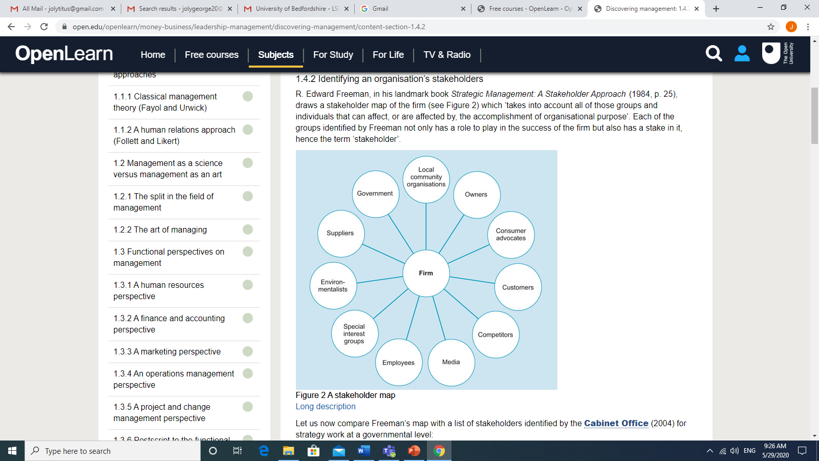
STAKEHOLDER MAP

Slide 11


10 minutes break

Slide 12
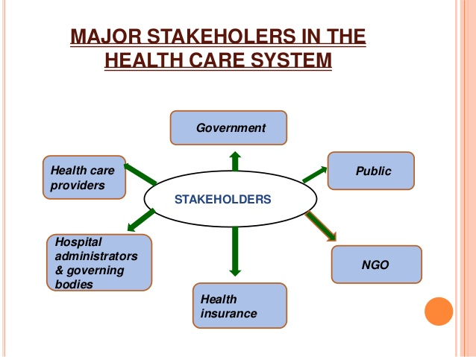

Slide 13
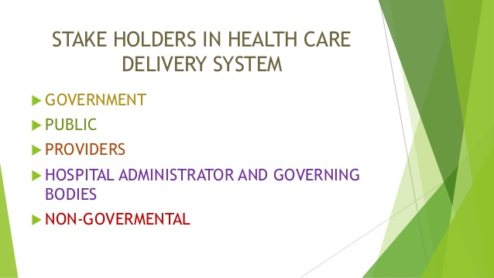

Slide 14
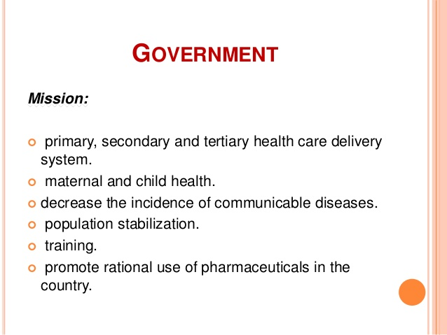

Slide 15
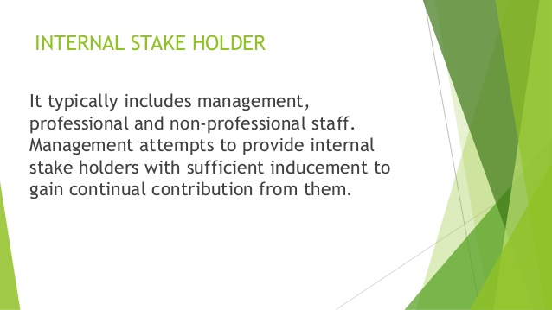

Slide 16
Internal stakeholders in healthcare
Internal stakeholders are people who are already committed to serving your organization as board members, staff, volunteers, and/or donors.
Internal Stakeholders - those who operate within an organisation, in this case generally Hospital staff.

Slide 17
Identifying internal stakeholders
Service users
Service users families
Professionals.
Patients
Those who are important in people’s personal lives – their partners, carers, family members and friends – should remain important when they move into a care home.
They are vital to the residents’ wellbeing and safety. The sustained and accepted involvement of families and carers is one of their best protections against abuse and neglect.
(care and homes, 2020).

Slide 18
Examples of Internal Stakeholders
Almost entirely within the organization and typically include management, professional and nonprofessional staff.
The stakeholder determine whether the inducement are sufficient for the contribution that they required based on alternative contribution offer received from competitive.

Slide 19
WRAP-UP
Question and Answer Session

Slide 20
External stakeholders are people who are impacted by your work as clients/constituents, community partners, and others. It is important to get the perspectives of both groups.
External Stakeholders - stakeholders who are impacted or impact the Hospital, but are not employed by the Hospital.

Slide 21
External stakeholders
External stakeholders are entities not within a business itself but who care about or are affected by its performance (e.g., consumers, regulators, investors, suppliers).
External stakeholders are groups outside a business or people who don't work inside the business but are affected in some way by the decisions and actions of the business.
Examples of external stakeholders are customers, suppliers, creditors, the local community, society, and the government.
All internal and external stakeholders should be identified.
These will usually be the patients but often will include the patients' family members, healthcare providers, or program administrators.
(Identifying and managing internal and external stakeholder interests, 2020)

Slide 22
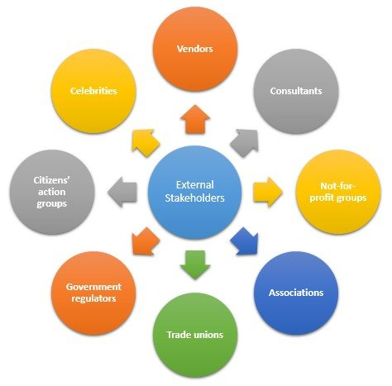

Slide 23
Examples of external stakeholders in healthcare
Special interest group are the government regulatory agencies (CQC, NICE, Nursing Midwifery council)
Private accrediting associations,
Professional associations,
Labour union,
The media and political group.

Slide 24
Stakeholders in Health Care System
Government -The role of government in the administration of health care can not be overestimated. Many federal government health care efforts are headed by a cabinet- level officer, the secretary for health and human services, who runs the department of health and human services.
The government makes budget and other planning related to expenditure in health care.
As the major payer, the federal government has been active in regulating the health care industry.
Public - The public has a stake in health care from several perspectives.
As consumers of health care services or as patients, the public is concerned with quality, cost and access to care.
Many people believe that health care is a right and should be universally available to all citizens, regardless of the cost.
In addition, the public has a more positive view of health promotion and illness prevention than in past.. Health care resources remain focused on illness, however, with only 1% of health care expenditures going to public health.

Slide 25
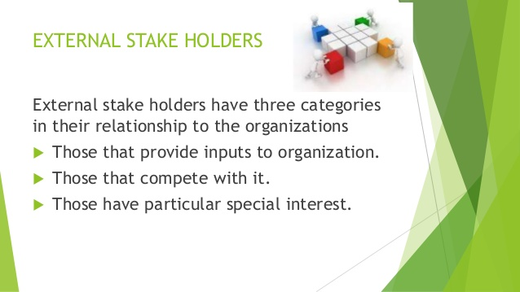

Slide 26
United Kingdom Accreditation Service (UKAS)
The United Kingdom Accreditation Service is the sole national accreditation body recognised by the British government to assess the competence of organisations that provide certification, testing, inspection and calibration services
Does accreditation affect quality?
Studies have shown that accreditation improves the overall quality of care in healthcare facilities. In certain specialty areas, accreditation programs even improve patient outcomes. ... The standards ensure that patients will receive consistent, excellent care throughout the facility.
What does accreditation mean in healthcare?
Accreditation is usually a voluntary program in which trained external peer reviewers evaluate a healthcare organization's compliance and compare it with pre-established performance standards.
What is accreditation process?
Accreditation is the process of formal recognition of competence that grants approval to qualified organizations, including Certification Bodies (CBs), who are then given the ability to perform certification audits.

Slide 27
External Stakeholders
Internal Stakeholders
Director of Public Health
Head of Health Intelligence and Information
Service users
Patients
Procurement
Director of Nursing
Public Health Strategists
Public Health Management Analyst
Director of Programmes and Services
Research Scientist
Communications
Environmental Health Intelligence Analyst
Public Health Manager
Trustees
Board committee members
Local Authority/council
Providers
Acute trusts
Patients
Service users
Customers
Suppliers
Funders
Quality assessors
LINk group
Special interest groups
Health visitors/school nurses
Wider public health workforce
Media

Slide 28
Stakeholder engagement – what is it?
Stakeholder Engagement is a process by which an organisation or local health community learns about the perceptions, issues and expectations of its stakeholders and uses these views to assist in managing, supporting and influencing any planned changes/improvements in service delivery.
• Service users are those who use services or those who may use them. Service user involvement can be directly or through representatives.

Slide 29
Effective stakeholder engagement
We particularly recognise the value and importance of effective stakeholder engagement.
Effective stakeholder engagement requires strong and enduring relationships between the Trust and local people, which continue even in times of challenge or pressure.
It relies on having a good understanding of our various perspectives and our respective areas of interest and concern. We cannot achieve this Strategy alone.
We collaborate closely with representatives of some of the Trust’s key stakeholders, including the Health and Adult Social Care Scrutiny Panel, Health and Wellbeing Board, Isle of Wight Clinical Commissioning Group (CCG), Healthwatch IoW, Community Action Isle of Wight, Isle of Wight Council and our Patient Council.
All have an important part to play.

Slide 30
STAKEHOLDER ENGAGEMENT – WHY IS IT IMPORTANT?
Most people naturally place a high value on their health and the health of their families and friends.
As a consequence, services provided to local people by the NHS are of particular importance and interest to both individuals and groups – whether these services are provided in the community or in hospital.
Building relationships based on mutual understanding and trust Effective stakeholder engagement is about building sustainable relationships with people who are affected by what we do and the services which we provide, and who have a contribution to make with regard to what we do.
It relies on a commitment to engage, listen, respond and communicate openly and honestly with stakeholders.

Slide 31
Through working with our stakeholders, we believe that we can achieve improved mutual understanding and trust. By sharing more about the work which we do and how we do it, about our successes and our challenges, we hope that local people will feel that they know us better as the organisation which cares for them when they need our services.
Through maintaining regular two-way dialogue we will also be able to listen to, and understand more clearly, the issues, concerns and ideas of local people. This also enables us to make improvements to the ways in which we provide our services.

Slide 32
LO2-Activity- Class Discussion – 20mins
What are the roles of stakeholders in NHS?.

Slide 33
Keeping stakeholders informed and involved
NHS England works closely with stakeholders and staff to ensure they are involved in all stages of the development of PCS services.-Primary Care Support (PCS) Services
To ensure that NHS England and NHS Improvement, as the commissioner for primary care support services, understands the views of key stakeholders and enables them to influence the delivery and direction of the services, a stakeholder forum has been constituted.
Membership of the stakeholder forum includes:
British Medical Association (BMA)
Local Optical Committee Support Unit (LOCSU)
Optical Confederation, Pharmaceutical Services Negotiating Committee (PSNC)
British Dental Association (BDA)
Royal College of GPs (RCGP).
Role of NHS England

Slide 34
Meeting service user needs
Recognising users of services as individuals
Recognising and actively promoting respect for diversity, difference and adopting inclusive practices
Taking a holistic approach to meeting needs and safeguarding/protection: physical, mental, social, emotional, cognitive, e.g. including communication
Providing individuals with the tools for self-determination
Enabling service users’ ownership of their own care journey
Integrating service user feedback and experience into quality improvement measures

Slide 35
Impact of NHS staff as a stakeholder in quality improvement
Enabling an effective working partnership with other professionals, e.g. partnership working, collaborative approaches
Increasing job satisfaction
Lowering stress levels
Reducing attrition rates
Improving professionalism in the service
Positive working environment and constructive processes
Addressing patient needs, ensuring patient safety, efficiency of the system, and quality improvement, healthcare system performs far below acceptable levels.
Improving the health of the population, enhancing patient experiences and outcomes, and reducing the per capita cost of care, and to improving provider experience.

Slide 36
Meeting staff needs
Developing and supporting staff through provision of appropriate training, appraisal processes and performance management
Actively promoting equality and diversity and inclusion
Appropriate delegation of responsibilities
Safeguarding and protecting staff

Slide 37
Taking a holistic approach to meeting needs and safeguarding/protection:
Safeguarding is so important because abuse is still very much happening, and sadly, it is often these most vulnerable citizens who are commonly victims of abuse. These people deserve to live in a safe environment, away from harm – which makes safeguarding of great importance during their care.
Providing individuals with the tools for self-determination
The aim has been that people should have a stronger voice in decisions about health and care, and that services should better reflect their needs and preferences.
how service users experience quality care, especially in relation to having choices and making decisions.
Self-determination is a vital piece of psychological well-being; as you may expect, people like to feel control of their own lives.
(Self-Determination Theory of Motivation: Why Intrinsic Motivation Matters, 2020)

Slide 38
Enabling service users’ ownership of their own care journey
Enable service users to recognise and develop their strengths and abilities, so they can live an independent and fulfilling life. Providing person-centred care requires involving patients in decisions and helping them take actions to support themselves.
As a healthcare practitioner, you should learn about the benefits of providing person-centred care and how to apply it in practice. It’ll help you fulfil your role to the best of your abilities and maximise your service users’ quality of life.
(Burton and Burton, 2020).

Slide 39
Delivering person-centred to Meet service user needs
Delivering person-centred care involves caring for patients beyond their condition and tailoring your service to suit their individual wants and needs.
It’s about respecting that they have their own views on what’s best for them, and have their own values and priorities in life.
As its name suggests, person-centred care puts the person at the heart of their care.
You adapt your service to their expectations and preferences, not the other way around.
Doing so enables patients to retain their dignity and autonomy during an already challenging time.
Rather than leaving them feeling hindered by their ailment or disability, or debilitated during their time as an inpatient, you help them live a fulfilling life.
(Burton and Burton, 2020).

Slide 40
Impact of service user feedback and experience as a stakeholder in quality improvement
When patients feel they're being listened to and their feedback matters, it can help your practice improve patient engagement, which is the key to improved retention and health outcomes.
Improving Quality is being established to bring together the ... improve the experiences of people who use health and social care services, their carers ... range of activities that capture direct feedback from patients, service users, ... Integrating patient experience measurement systems into existing work.
To improve care
The best way to understand the patient experience is from patients themselves. Asking for patient feedback about everything from appointment scheduling and wait time, to the doctor’s bedside manner, thoroughness, communication skills and professionalism, you can make get a 360-degree view of the quality of care your patients are receiving versus what you perceive you’re providing
Measuring patients’ experiences of care and treatment highlights areas that need to improve to provide a patient-led healthcare service.
It help you to involve patients, staff and the public in translating patient feedback into real improvements.

Slide 41
Cont.…
Service user and carer feedback can inform critical reflection, individual supervision, appraisal and continuing professional development.
Direct feedback enables us to assess the quality of working relationships between service users, carers and practitioners and it can be used to improve people’s experiences of processes and relationships as well as outcomes – as service users and families often say, it is not just what social workers do but how they provide support and the relationship context that is so important for recovery and empowerment.
Individual and group feedback can be collated and analysed to measure and improve individual, team and organisational performance against practice standards (e.g. the Professional Capabilities Framework).

Slide 42
Approaches to gathering service user’s feedback
Focus groups
One-to-one interviews
Observation in healthcare settings
Patient panels
Deliberative events/citizen’s juries
Telephone surveys
Online surveys

Slide 43
Impact of improving quality on service user
Enhanced self-esteem
Enriched service user satisfaction and trust levels
Improved, high-quality healthcare
Developed approaches to inclusion and wellbeing
Improved experience of services
Enhanced safety
Enhanced clinical effectiveness
Enhanced relationships with families, and caregivers
More effective transition between different services

Slide 44
WRAP-UP
Question and Answer Session

Slide 45

Summary of today’s lesson
In this session:
All / most learners were able to:
1-Define stake holders in health and social Care .
2-Outline the roles of stakeholders in Health and Social Care

Slide 46
Reference
Health Knowledge. 2020. Identifying And Managing Internal And External Stakeholder Interests. [online] Available at: <https://www.healthknowledge.org.uk/public-health-textbook/organisation-management/5b-understanding-ofs/managing-internal-external-stakeholders> [Accessed 3 November 2020].
Burton, L. and Burton, L., 2020. Person-Centred Care Guidance. [online] The Hub | High Speed Training. Available at: <https://www.highspeedtraining.co.uk/hub/what-is-person-centred-care/> [Accessed 3 November 2020].
care, P. and homes, P., 2020. Care Homes: Carers, Families And Friends Are Your Partners - SCIE. [online] Social Care Institute for Excellence (SCIE). Available at: <https://www.scie.org.uk/person-centred-care/older-people-care-homes/families-carers> [Accessed 3 November 2020].
PositivePsychology.com. 2020. Self-Determination Theory Of Motivation: Why Intrinsic Motivation Matters. [online] Available at: <https://positivepsychology.com/self-determination-theory/> [Accessed 3 November 2020].
The Script. 2020. 6 Reasons Patient Feedback Is Important. [online] Available at: <https://thescript.zocdoc.com/6-reasons-patient-feedback-is-important/> [Accessed 3 November 2020].
Further reading about patient feedback @ :
https://thescript.zocdoc.com/6-reasons-patient-feedback-is-important/
http://www.nhssurveys.org/Filestore/documents/QIFull.pdf
(6 Reasons Patient Feedback is Important, 2020).
https://www.england.nhs.uk/primary-care/primary-care-commissioning/transforming-primary-care-support-pcs-services/keeping-stakeholders-informed-and-involved/
https://www.healthknowledge.org.uk/public-health-textbook/organisation-management/5b-understanding-ofs/managing-internal-external-stakeholders

